Slide 1


Department of BES-1
DATA STRUCTURE
24SC1203
Topic:
AVL TREE implementation(insertion)
Session – 29

Slide 2



AIM OF THE SESSION
To familiarize students with the basic concept of AVL tree and its operations
INSTRUCTIONAL OBJECTIVES
This Session is designed to:
List out the rotations perform on AVL Tree.
Describe the balance factor.
LEARNING OUTCOMES
At the end of this session, you should be able to:
Define AVL Tree and Balance factor.
Describe the operation on AVL Tree.

Slide 3
SESSION INTRODUCTION
AVL Tree
The AVL tree name comes from Adelson – Velskii and Landis.
The AVL tree is Self-balanced binary search tree.
AVL tree is defined as height balanced binary search tree in which each node is associated with a balance factor which is calculated by subtracting the height of its right sub-tree from that of its left sub-tree.

Slide 4

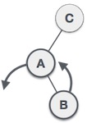

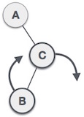
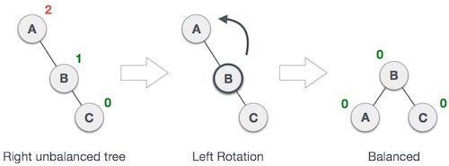
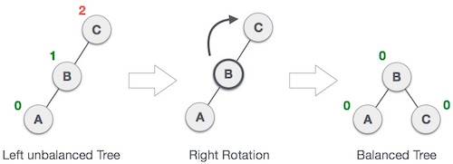
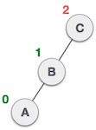
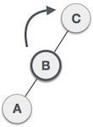
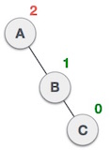
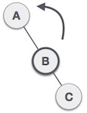
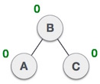
SESSION DESCRIPTION (Cont..)
AVL Rotation
If the difference in the height of left and right sub-trees is more than 1, the tree is balanced using some rotation techniques.
The first two rotations are single rotations, and the next two rotations are double rotations.
1. Left rotation | 2. Right rotation | 3. Left – Right rotation | 4. Right – Left rotation

Slide 5


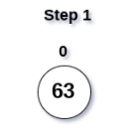
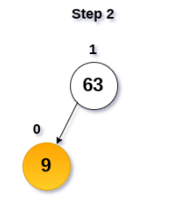
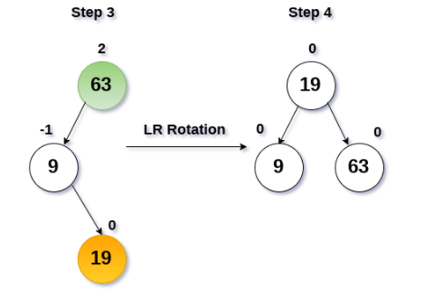
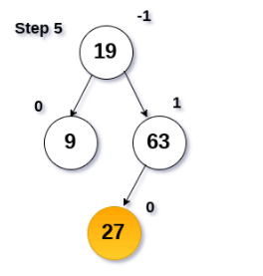
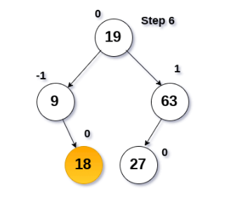
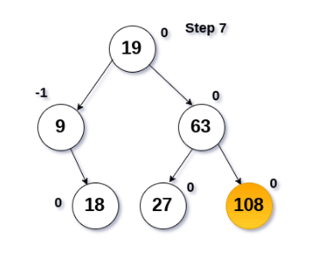
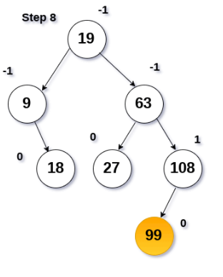
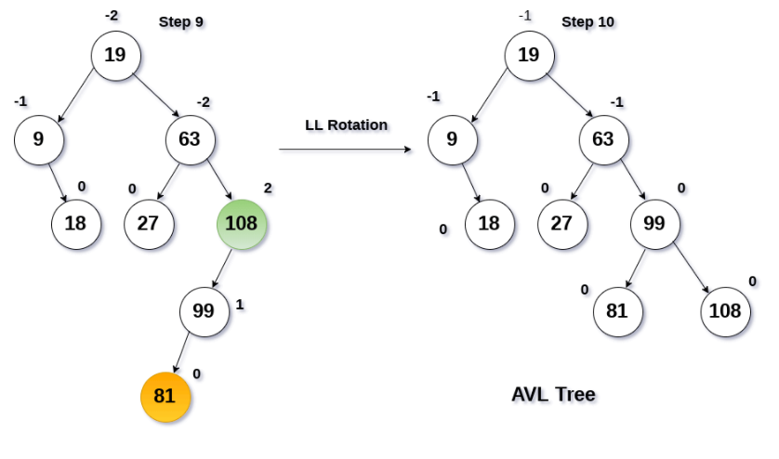
EXAMPLES
Construct an AVL tree by inserting the following elements in the given order.
63, 9, 19, 27, 18, 108, 99, 81

Slide 6
SUMMARY
Ø What is AVL Tree?
Ø AVL Tree- Rotations
Ø AVL Tree- Operations

Slide 7
SELF - ASSESSMENT QUESTIONS
Why we need to a binary tree which is height balanced?
a) to avoid formation of skew trees
b) to save memory
c) to attain faster memory access
d) to simplify storing
Which of the following rotations is called a double rotation in AVL Tree?
a) RL and RR
b) LR and RL
c) LL and RR
d) More than one of the above.
e) None of the above.

Slide 8
TERMINAL QUESTIONS
1. Describe the AVL Tree and Balance Factor?
2. List out the rotations perform on AVL Tree?

Slide 9
REFERENCES FOR FURTHER LEARNING OF THE SESSION
Reference Books:
1. A.V.Aho, J. E. Hopcroft, and J. D. Ullman, “Data Structures And Algorithms”, Pearson Education, First Edition Reprint2003.
2. Horowitz, Sahni, Anderson Freed, “Fundamentals of data structures in C” , Second Edition-2007.
3. R. F. Gilberg, B. A. Forouzan, “Data Structures”, Second Edition, Thomson India Edition, 2005
Sites and Web links:
https://nptel.ac.in/courses/106101060/4
https://www.edx.org/course/algorithms-and-data-structures-12.
3. https://practicepaper.in/gate-cse/avl-tree

Slide 10
THANK YOU
BES-1 – Data Structure

